Slide 1
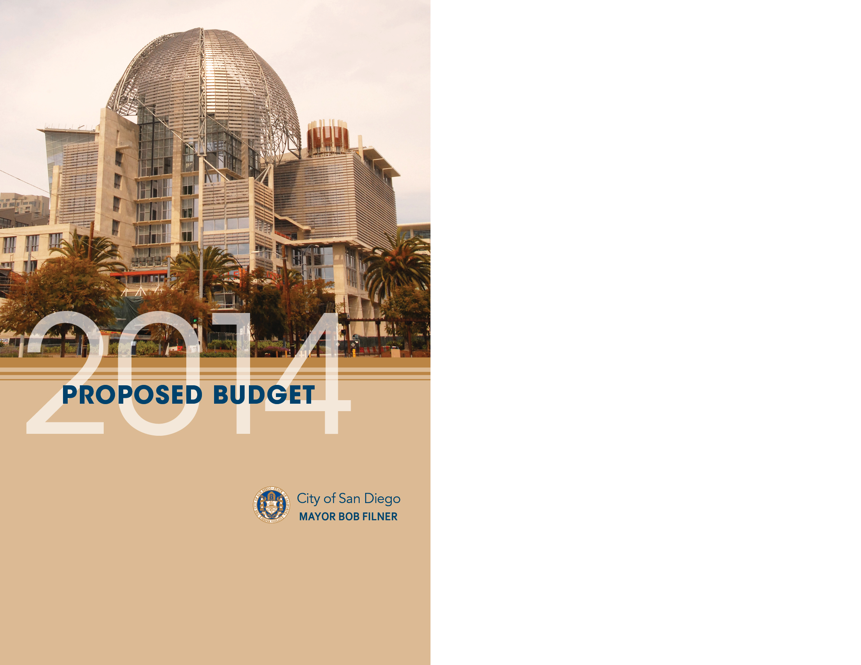
Public Utilities Department
Metro Fund
May 29, 2013

Slide 2

Fiscal Year 2014 Proposed Budget
Non-General Fund Department Summary
May 29, 2013
Public Utilities Department

Slide 3
Metro Fund Revenue
Total FY 2014 Budget $92,163,000
Notes:
Double-click table to enter data.
Sewer Service Charge-Revenues from water/sewer bills mailed monthly or bi-monthly to retail (SF, MF, Comm/Ind) customers
Maint & Operation Metro-Revenue from 15 Participating Agencies for treating their sewage
Revenue Bonds Issued-Reimbursement from PFFA for CIP-related expenses
State Revolving Fund-Loan Proceeds for CIP projects
Interest on Pooled Investments-Interest calculated on wastewater’s share of “pooled” cash
Capacity Charges-Fees for connection to sewer system for new construction or additional capacity
Groundwater Discharge Permit Fees-Fee-Revenues from businesses discharging groundwater to the sewerage system or its tributary systems
Sewer Service Charges-Shipboard Waste-Treatment of Navy sewage from meters USN6, 7, 8, and NC4M).
Reimbursements Between Funds/Depts-For services rendered to other departments under an SLA
Truck(ed) Water Permit-Permit and disposal fees mandated by federal regulations to recover costs of permit issuance, monitoring & testing samples, and treatment costs of permitted wastewater trucked to PS1.
Sewer Service Charge-Misc (Non-CIS) is revenue from Prisons (East Mesa Detention Facility & R.J. Donovan Correctional Facility)

Slide 4
Metro Fund Revenue 3-Year
Budget vs Actuals
Notes:
Double-click table to enter data.

Slide 5
Metro Fund Expenditures
Debt includes SRF Loan Payments

Slide 6
Metro Fund 3-Year
Budget vs Actuals
Notes:
Double-click table to enter data.

Slide 7
Wastewater 3-Year
Budget vs Actuals (cont.)

Slide 8
Metro Fund
Variance Analysis
Notes:
Double-click table to enter data.

Slide 9
Supplies
Total FY14 Supplies Budget = $20,390,282

Slide 10
Contracts
Total FY14 Contracts Budget = $49,271,214

Slide 11
Information Technology
Total FY14 Information Technology Budget = $6,698,956

Slide 12
Energy & Utilities
Total FY14 Energy & Utilities Budget = $13,790,648

Slide 13
Capital Expenditures
Total FY14 Capital Expenditures Budget = $1,246,977

Slide 14
Transfers Out / Other / Debt Expenditures
Total FY14 Transfers Out, Other Expenditures, Debt Budget = $62,972,764

Slide 15
Capital Improvement Program
Metro

Slide 16
Questions?

